Slide 1




Borcelle Company
Sales
Analysis
Business Presentation
Niloy Saha
Presented by :
www.reallygreatsite.com

Slide 2
Borcelle Company
Introduction
  The company is a multi-store retail business operating across multiple cities.
  It deals in various product categories such as Snacks, Beverages, Dairy, Bakery, and Personal Care.
  The business manages sales, inventory, and product distribution across stores.
  The goal is to maximize sales and profitability while maintaining optimal inventory levels.

Slide 3

Borcelle Company
Problem Statement
The retail business is facing challenges in understanding its sales performance and inventory efficiency across multiple stores and product categories. Despite having large volumes of data, the business lacks clarity on:
  Which products and categories drive the most revenue and profit
  Whether inventory levels are aligned with sales demand
  How sales and profit trends change over time
  Which areas are causing low profitability or inefficiencies

Slide 4
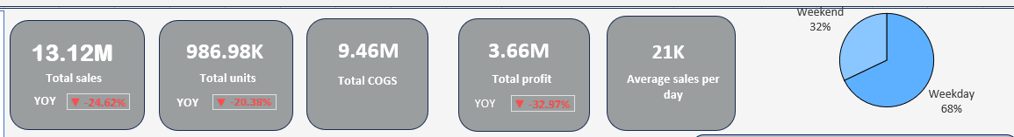
Sales overview
Borcelle Company
  Total sales is about 13.12 million
  Total profit is 986.98 K
  Sales declined significantly (↓24.62% YoY), indicating a drop in overall business performance
  Units sold also decreased (↓20.38%), showing reduced customer demand
  Profit dropped sharply (↓32.97%), faster than sales → clear margin pressure
  COGS remains high (9.46M), suggesting potential cost inefficiencies or low-margin products
  68% sales occur on weekdays, highlighting untapped weekend opportunity

Slide 5
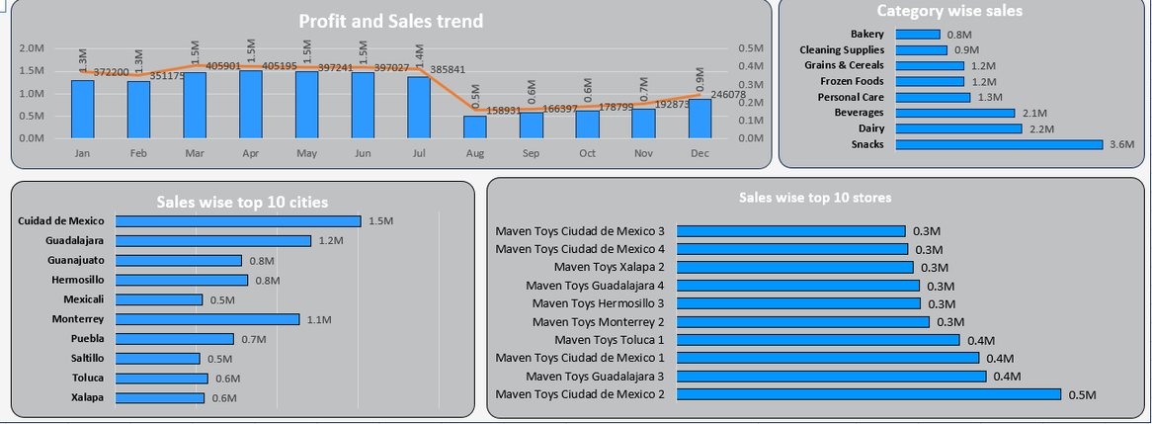
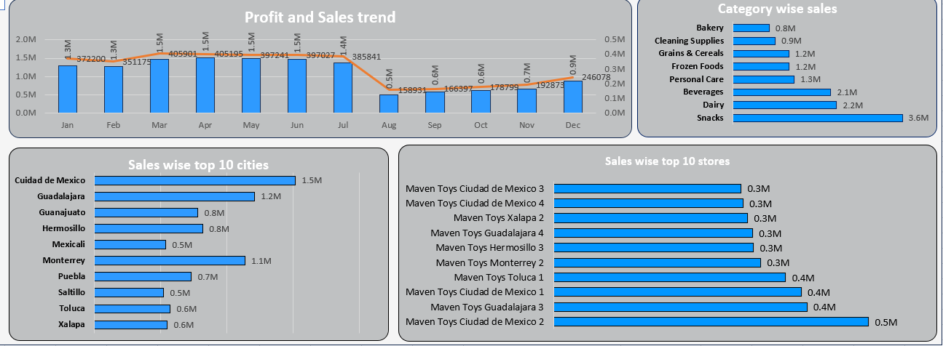
Sales analysis
Borcelle Company
  Profit is falling faster than sales, showing inefficiency in cost management or low-margin product mix
  Snacks is the top-performing category (3.6M sales), while Bakery is the lowest (~0.8M) → clear category performance gap
  Sales trend shows a sharp dip around Aug–Sep, indicating possible seasonality or operational issues
  Weekday contributes 68% of sales, meaning business is highly weekday dependent → weekend growth opportunity
  Top cities like Ciudad de Mexico & Guadalajara drive major revenue, showing geographical concentration of sales
  Few stores dominate sales (Top stores ~0.4–0.5M) → performance is not evenly distributed across stores

Slide 6
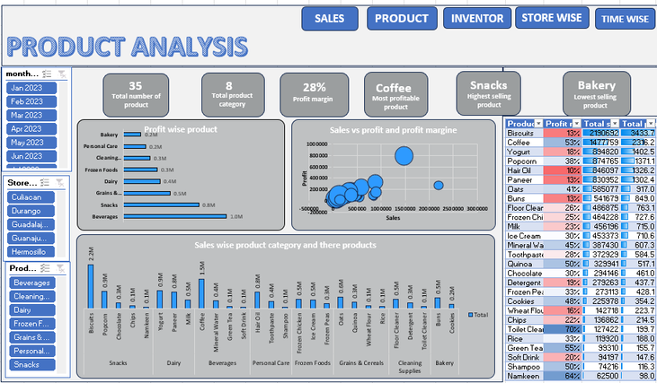
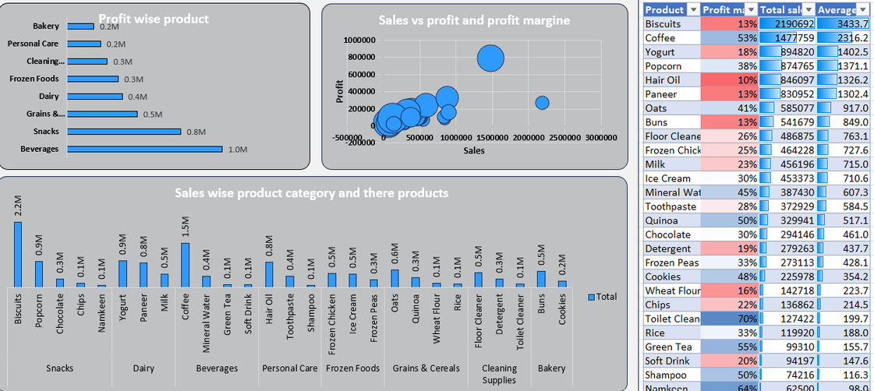


Product analysis
Borcelle Company
  Snacks is the highest selling category (~3.6M sales), contributing the largest share of revenue → key revenue driver
  Bakery is the lowest performing category (~0.8M sales) → potential area for improvement or cost optimization
  Coffee is the most profitable product, indicating strong margin performance despite category competition
  Overall profit margin is 28%, showing a moderately healthy business but with scope for improvement
  High sales ≠ high profit: Scatter plot shows some products with high sales but relatively lower profit → margin inefficiency
  Snacks is highest sale product but 2nd in profit but Beverage is 3rd in sales wise but profit wise it’s 1st .
  Products like Namkeen and Shampoo show high profit margins (up to ~60–70%) → potential candidates for promotion and scaling
  Certain products have low sales and low margin (e.g., Bakery items) → may need rationalization or repositioning
  Category contribution is uneven, with Snacks and Beverages dominating → business is dependent on few categories

Slide 7
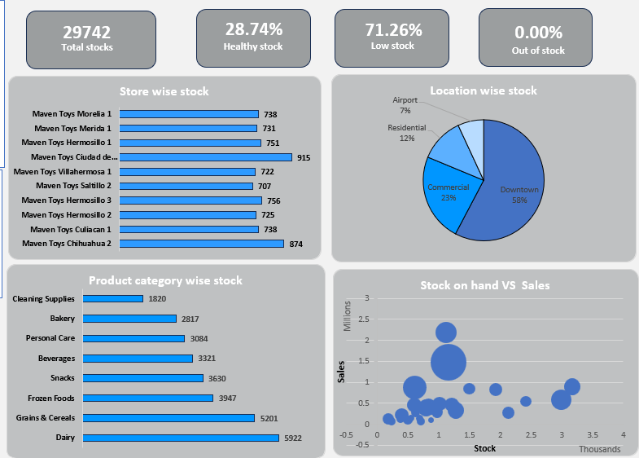

Inventory wise
Borcelle Company
  Total stock = 29,742 units, indicating strong inventory availability across stores
  Only 28.74% stock is healthy, while 71.26% is low stock → major inventory risk.
  Out-of-stock is 0%, meaning availability exists but not at optimal levels
  Downtown holds 58% of total stock, showing heavy location concentration
  Dairy (5,922) and Grains & Cereals (5,201) dominate inventory, while Cleaning Supplies is lowest (1,820)
  Stock vs Sales scatter shows imbalance, with some products having high stock but low sales → inefficiency
  Store-level stock is uneven, with some stores holding significantly higher inventory

Slide 8
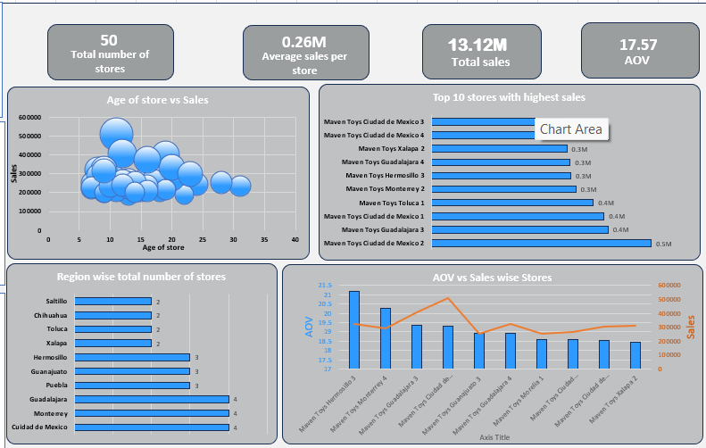
Store wise
Borcelle Company
  Total Sales = 13.12M across 50 stores, indicating a moderate revenue distribution per store
  Average sales per store = 0.26M, showing scope for store-level performance improvement
  AOV (Average Order Value) = 17.57, suggesting low per-transaction value → upselling opportunity
  No strong correlation between store age and sales → older stores are not necessarily top performers
  Top stores (e.g., Ciudad de Mexico locations) contribute highest sales (~0.4M–0.5M) → performance is concentrated
  Region-wise distribution shows uneven store presence, with cities like Mexico City & Monterrey having more stores
  AOV vs Sales chart shows mismatch → some stores have high sales but low AOV, indicating high volume but low value transactions

Slide 9
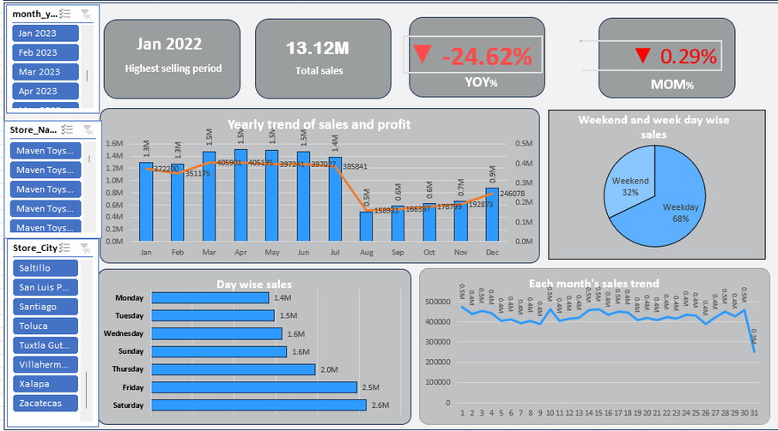
Time wise
Borcelle Company
  Total Sales = 13.12M across 50 stores, indicating a moderate revenue distribution per store
  Average sales per store = 0.26M, showing scope for store-level performance improvement
  AOV (Average Order Value) = 17.57, suggesting low per-transaction value → upselling opportunity
  No strong correlation between store age and sales → older stores are not necessarily top performers
  Top stores (e.g., Ciudad de Mexico locations) contribute highest sales (~0.4M–0.5M) → performance is concentrated
  Region-wise distribution shows uneven store presence, with cities like Mexico City & Monterrey having more stores
  AOV vs Sales chart shows mismatch → some stores have high sales but low AOV, indicating high volume but low value transactions

Slide 10
Recommendation
Borcelle Company
  Improve Inventory
Planning With 71% low stock, implement demand-based replenishment to avoid stock imbalance
  Focus on High-Margin Products
Promote products like Namkeen, Shampoo (high margin) to increase overall profitability
  Boost Low-Performing Categories
Categories like Bakery & Cleaning Supplies need pricing, promotion, or bundling strategies
  Increase Average Order Value (AOV)
Use cross-selling / combo offers to increase the current low AOV (17.57) 💡
  Optimize Store Performance
Identify low-performing stores and apply strategies from top-performing stores
  Reduce Sales Decline (YoY -24%)
Investigate causes (seasonality, competition, pricing) and introduce targeted campaigns
  Leverage Peak Days
Since Friday & Saturday drive highest sales, run special offers/ads on these days
  Balance Stock vs Sales
Use stock vs sales analysis to reduce overstock in low-selling products and avoid dead inventory

Slide 11


Borcelle Company
Thank You
nsaha3827@gmail.com
9836315141
Niloy Saha
Presented by :
www.reallygreatsite.com

